Slide 1
Basic presentation

Slide 2
Agenda
Introduction
Building confidence
Engaging the audience
Visual aids
Final tips & takeaways

Slide 3

The power of communication

Slide 4
Starting Point
SQL (Structured Query Language) used to retrieve data from databases (SELECT * FROM HumanResources.Employe WHERE ....
LLMs are quiet good in writing short SQL already
Many Analysts write SQL and use a lot of time for this

Slide 5
Problem
Database(s) contain thousand of tables and LLM (and Analysts as well) don’t know the structure

Slide 6
Goal
GIVE ME AN EXAMPLE SQL QUERY FOR THE ADVENTORUWORKS2016 DB
Create an Agent translating Business Questions from Analysts into SQL Queries

Slide 7
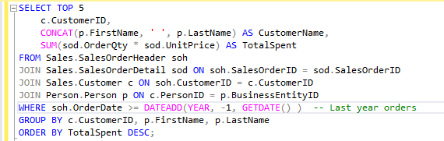
eXAMPLE
GIVE ME AN EXAMPLE SQL QUERY FOR THE ADVENTORUWORKS2016 DB
Which are the top 5 customers who have spent the most on orders in the last year?

Slide 8
TASK(s)
Create a Vectordatabase(s) containing information about the datamodel:
Documentation about Tables
Documentation about columns
Datamodel itself (relationship between tables)
For a given Business Questions find relevant Tables, Columns and Relationships between tables
For relevant tables also all intermediate tables need to be included -> Path in Graph between Tables need to be found: First approach Minimal Spanning Tree
Add information in an optimal way to an prompt

Slide 9
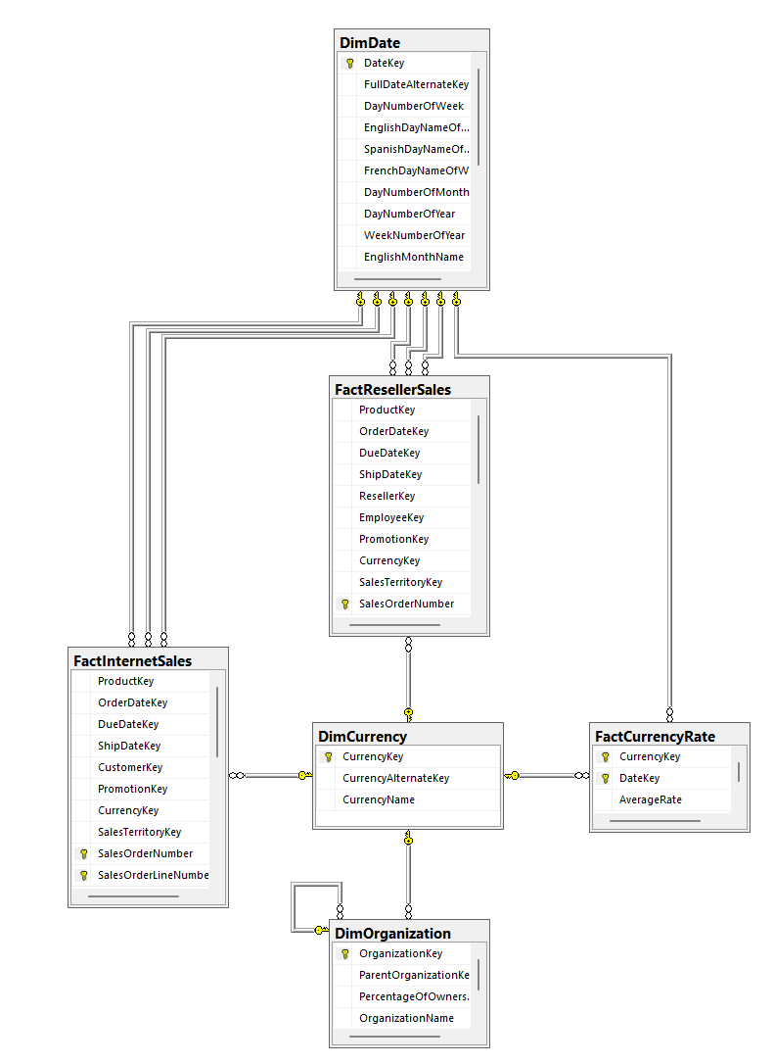
dATAMODEL
Relationship between Tables can be identifieds by
Foreign Keys
Potentially also just by Table & Column names:
Example:
HumanrRessource.Shift Table contains column “ShiftID”
HumanResources.EmployeeDepartmentHistory also contains column “ShiftID”
In AdventurWorks we also have a ForeignKey
In “Real World” Example no FKs might exists and ID naming could also be different: Most comen :
HumanrRessource.Shift -> Column “ID” as PK
HumanResources.EmployeeDepartmentHistory -> ShiftID

Slide 10
Infrastruktur
Postgres DB to store Vectordatabase
pgAdmin extension
MS SQL Light Database to Host Adventourvorks Data
SSMS to query MS SQL DB
pgAdmin to querry PostGres DB
LLM API Endpoint

Slide 11
Disclaimer
AdventourWork is public data and that knowledge might interfere with my tests

Slide 12
Extensions
Use indexes in Postgres to speed up search
Calculate embeddings within Postgres (much faster then in python)
Optimize length of promt
Instead of fullload of all embeddings into DB build ETL job able to also Update & Delete & Insert records individually
Scale up to bigger applications & datamodels which are not public: CRM System, Application Databases, ....

Slide 13

Overcoming nervousness​
Confidence-building strategies

Slide 14
Engaging the audience
Make eye contact with your audience to create a sense of intimacy and involvement
Weave relatable stories into your presentation using narratives that make your message memorable and impactful
Encourage questions and provide thoughtful responses to enhance audience participation
Use live polls or surveys to gather audience opinions, promoting engagement and making sure the audience feel involved

Slide 15
Selecting visual aids
Enhancing your presentation

Slide 16
Effective delivery techniques​
Voice modulation is a powerful tool in public speaking. It involves varying pitch, tone, and volume to convey emotion, emphasize points, and maintain interest:
Pitch variation​
Tone inflection​
Volume control
Effective body language enhances your message, making it more impactful and memorable:
Meaningful eye contact
Purposeful gestures
Maintain good posture
Control your expressions

Slide 17
Navigating Q&A sessions
Know your material in advance​
Anticipate common questions​
Rehearse your responses
Maintaining composure during the Q&A session is essential for projecting confidence and authority. Consider the following tips for staying composed:​
Stay calm​
Actively listen​
Pause and reflect​
Maintain eye contact

Slide 18

Speaking impact​
Your ability to communicate effectively will leave a lasting impact on your audience​
Effectively communicating involves not only delivering a message but also resonating with the experiences, values, and emotions of those listening

Slide 19
Dynamic delivery​
Learn to infuse energy into your delivery to leave a lasting impression​
One of the goals of effective communication is to motivate your audience
Metric​ | Measurement​ | Target​ | Actual​
Audience attendance​ | # of attendees​ | 150​ | 120​
Engagement duration​ | Minutes​ | 60​ | 75​
Q&A interaction​ | # of questions​ | 10​ | 15​
Positive feedback​ | Percentage (%)​ | 90​ | 95​

Slide 20
Final tips & takeaways​
Consistent rehearsal​
Practice makes perfect, so strengthen your familiarity with the presentation​
Refine delivery style​
Pacing, tone, and emphasis​
Timing and transitions​
Aim for seamless, professional delivery​
Practice audience
Enlist colleagues to listen & provide feedback​
Seek feedback​
Reflect on performance​
Explore new techniques​
Set personal goals​
Iterate and adapt

Slide 21
Speaking engagement metrics​
Impact factor​ | Measurement​ | Target​ | Achieved​
Audience interaction​ | Percentage (%)​ | 85​ | 88​
Knowledge retention​ | Percentage (%)​ | 75​ | 80​
Post-presentation surveys​ | Average rating​ | 4.2​ | 4.5​
Referral rate​ | Percentage (%)​ | 10​ | 12​

Slide 22
THANK YOU
Brita Tamm​
502-555-0152​
brita@firstupconsultants.com​
www.firstupconsultants.com

